Slide 1



Slide 2
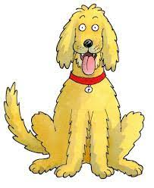
Oxford Reading Tree
Floppy’s Phonics programme
Our Floppy’s Phonics information powerpoint is designed:
to inform parents and carers about how phonics is taught in school
to help us to work in partnership to support children with their early reading

Slide 3
There have been many different methods of teaching early reading over the years!

Slide 4
What is phonics?
Recognising the sounds made by a letter/s in a word.
Synthetic phonics is
sounding out and blending the sounds
to read the unknown words

Slide 5
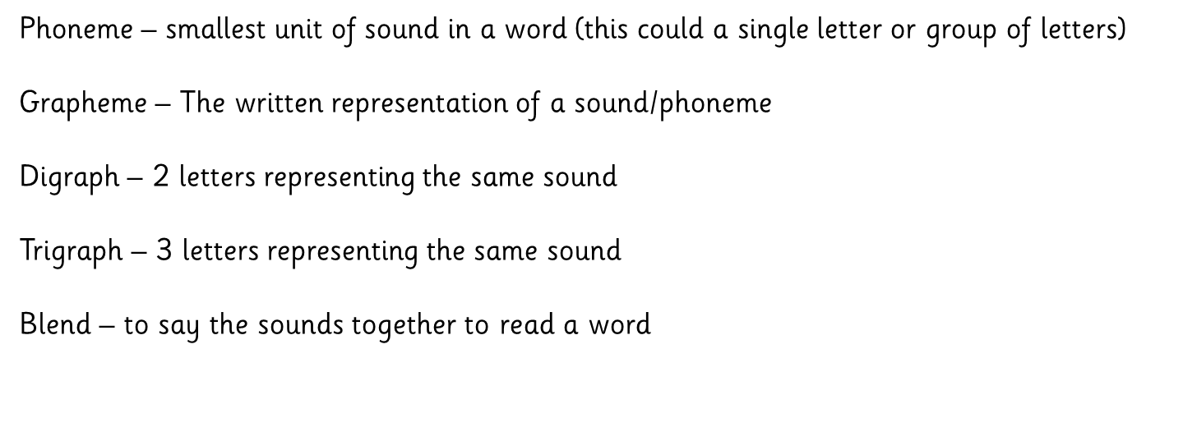
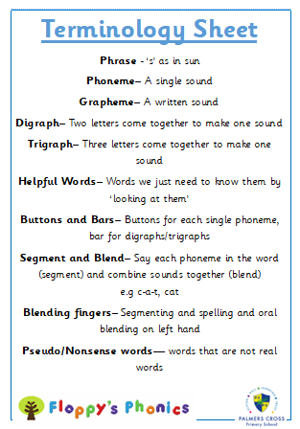
Terminology
Buttons and Bars
Blending fingers

Slide 6
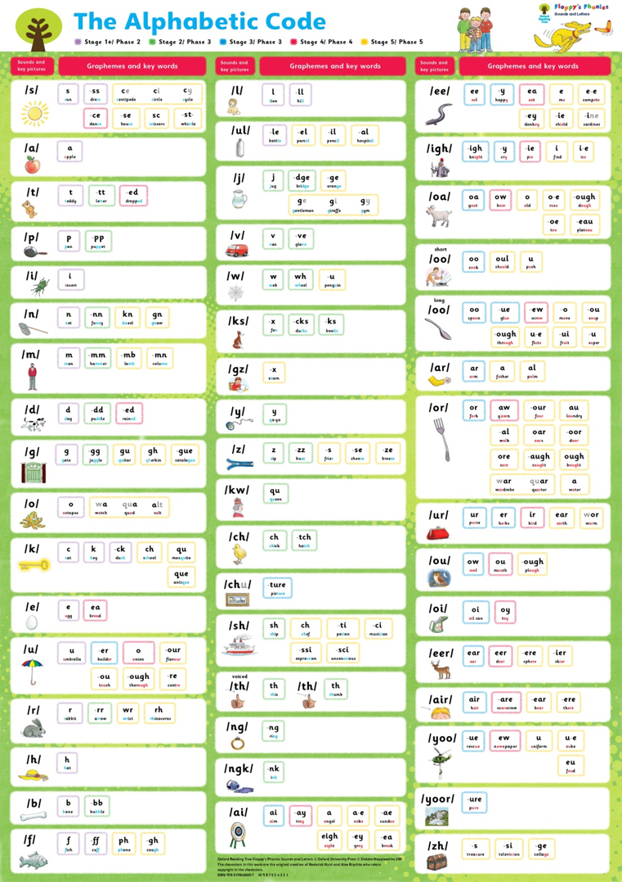
How we teach in school
Adult led Systematic:
A sequence of short planned lessons
Incidental:
individual
group
class
- as needed
Alphabetic Code Chart
Notes:
[Read from the slide.]

Slide 7
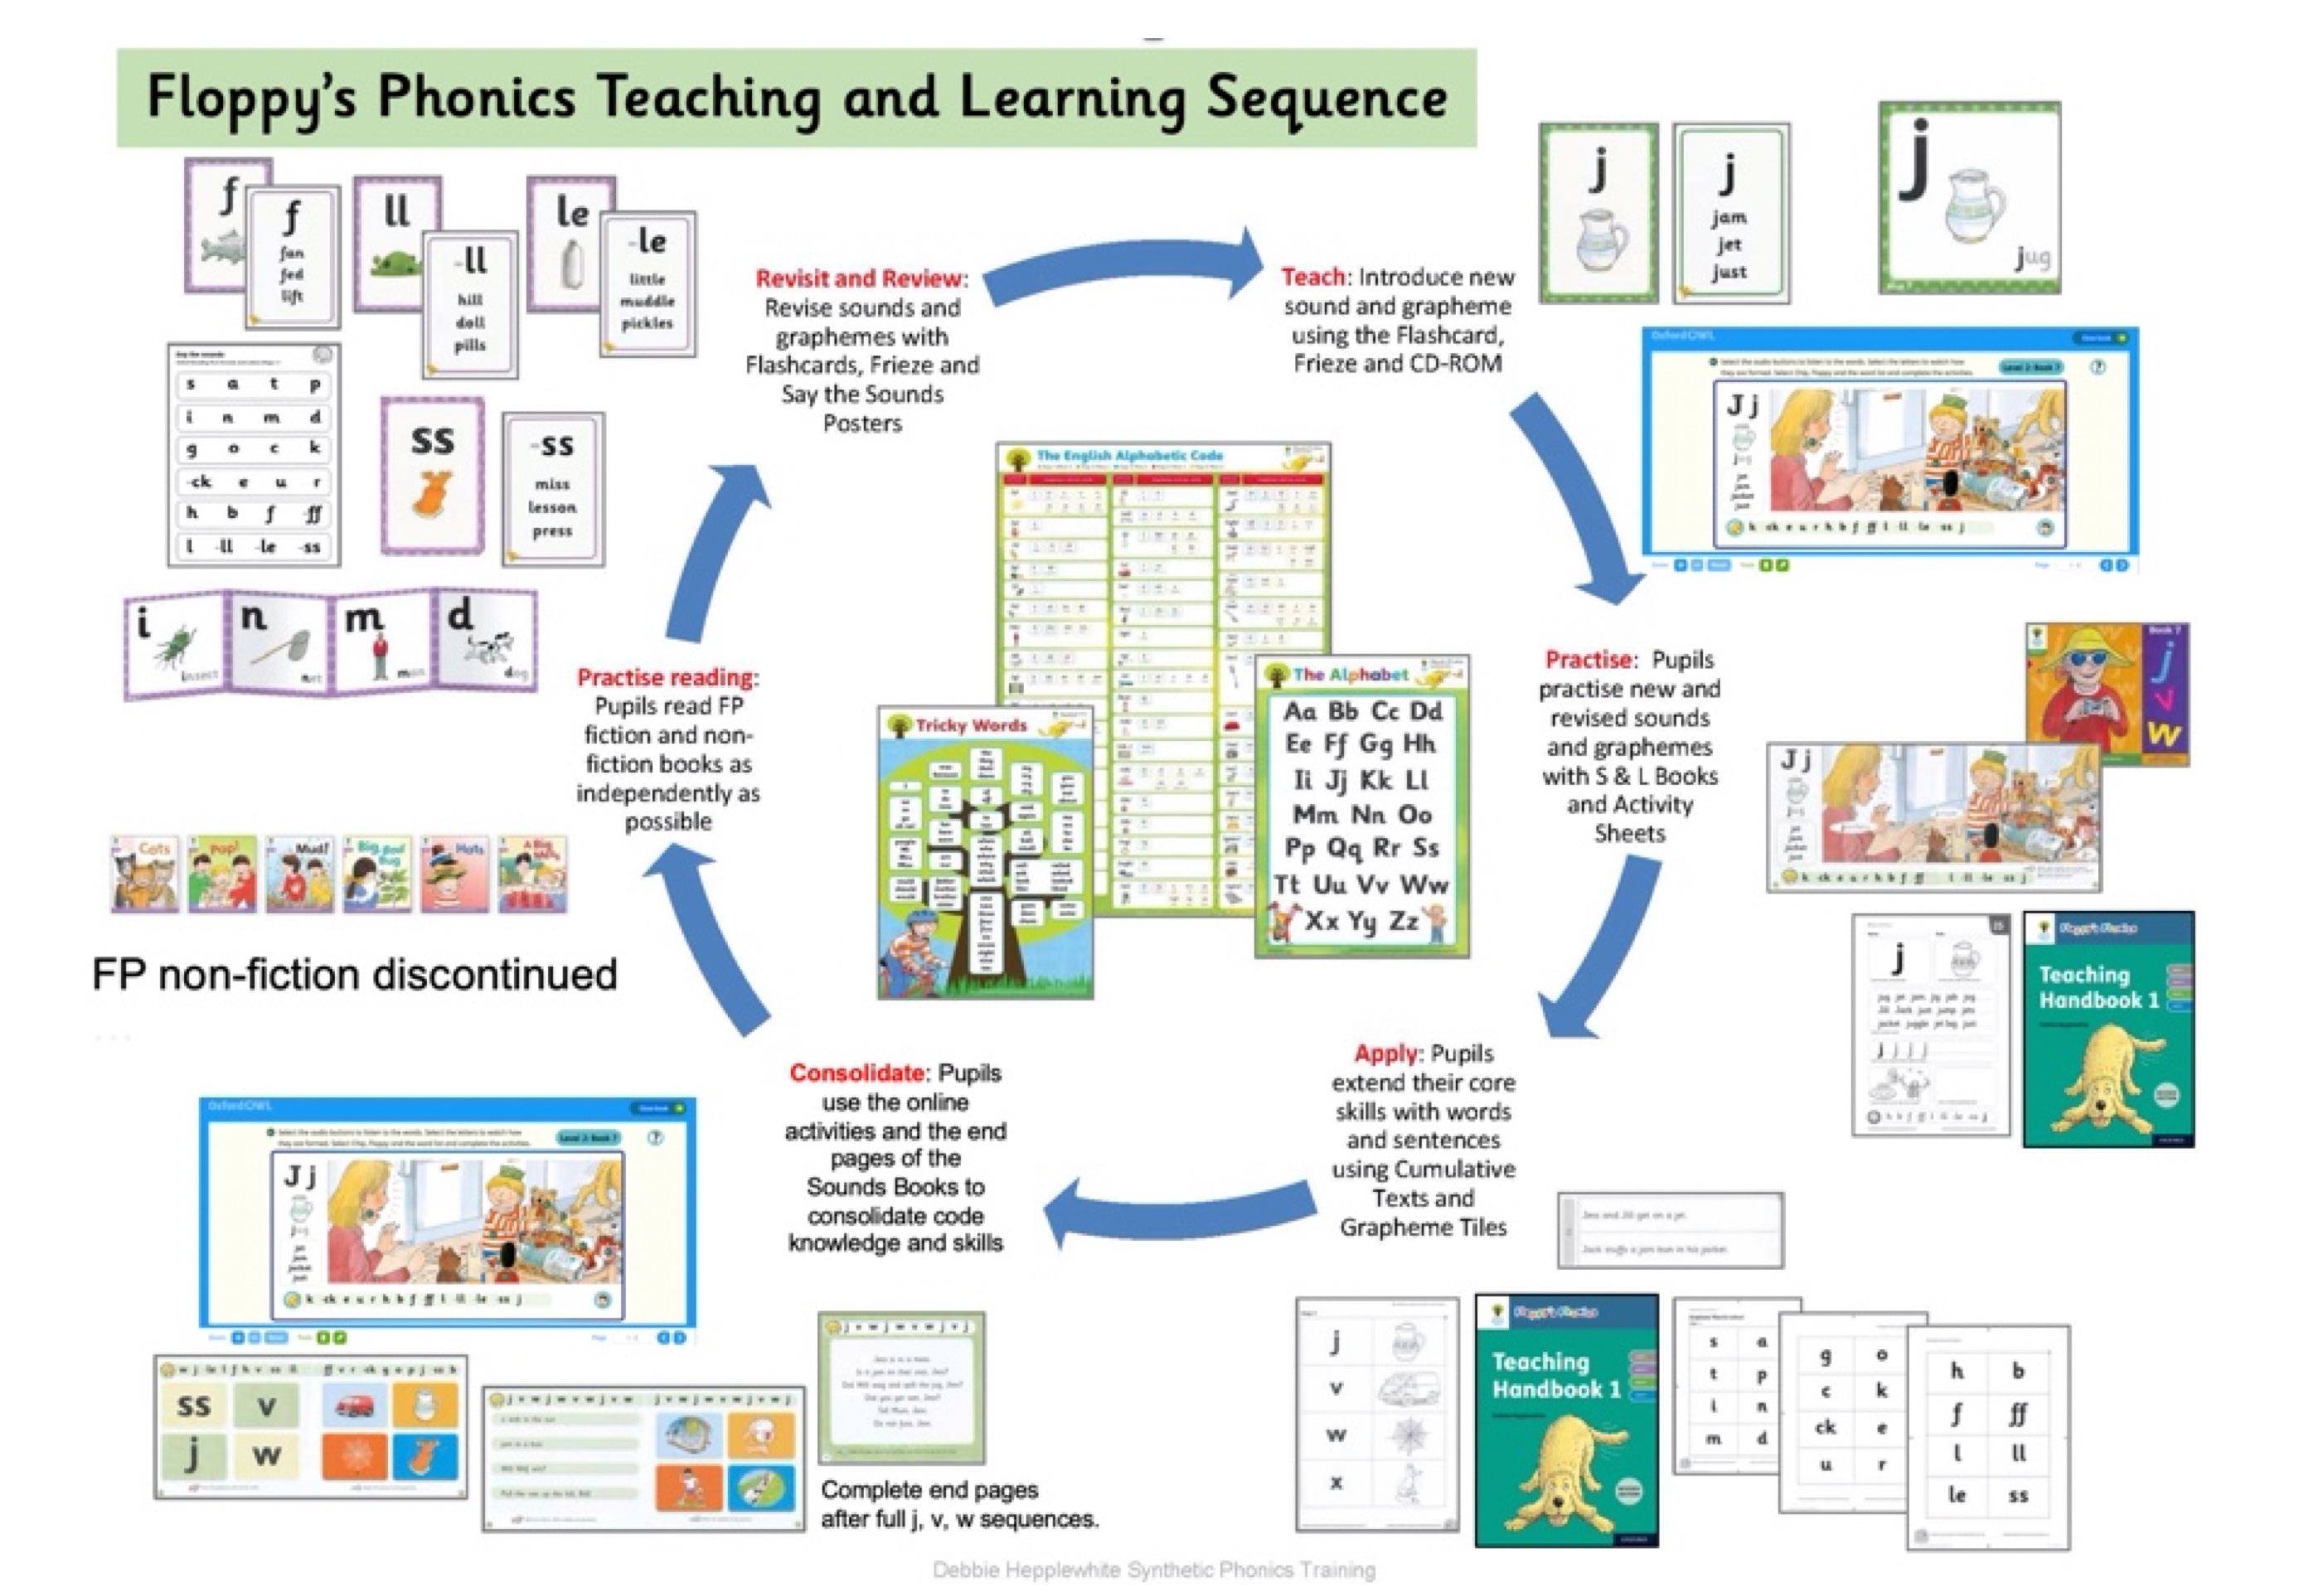
Teaching and Learning Sequence
Notes:
Show resources

Slide 8
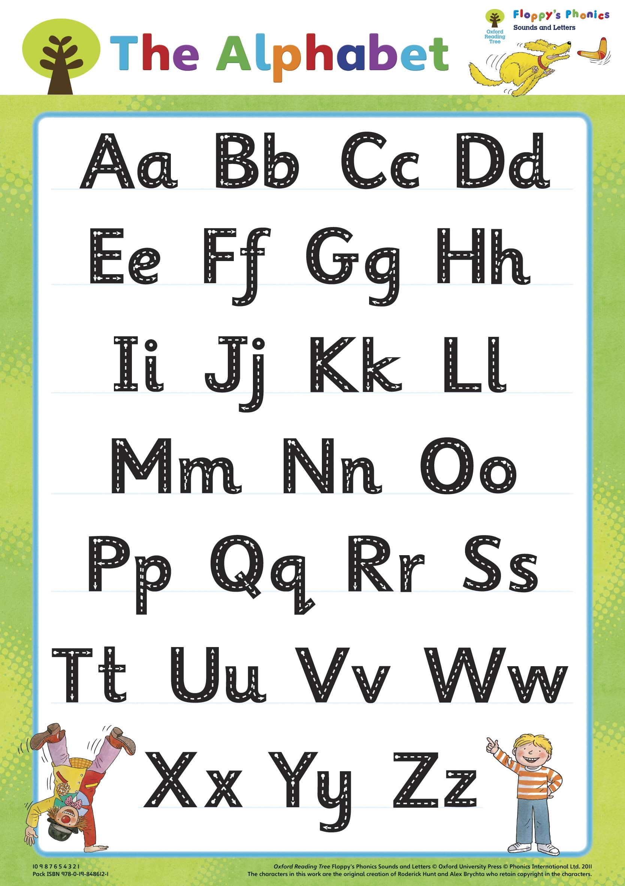
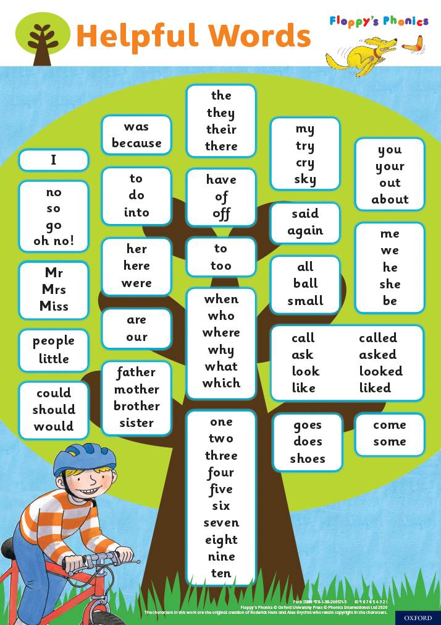
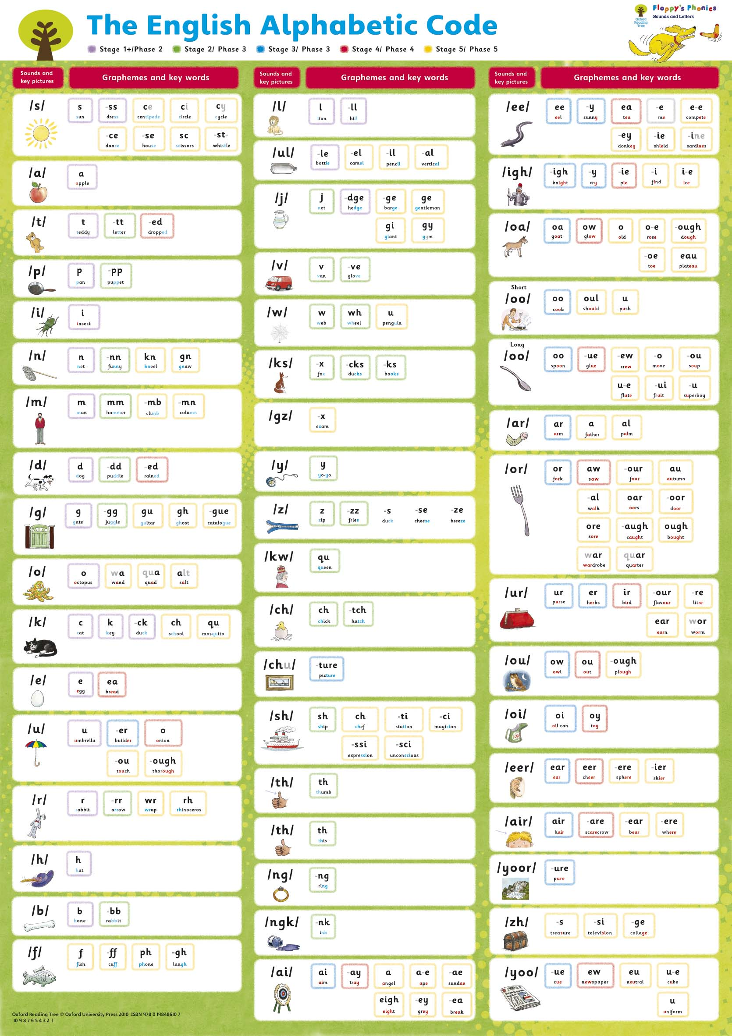
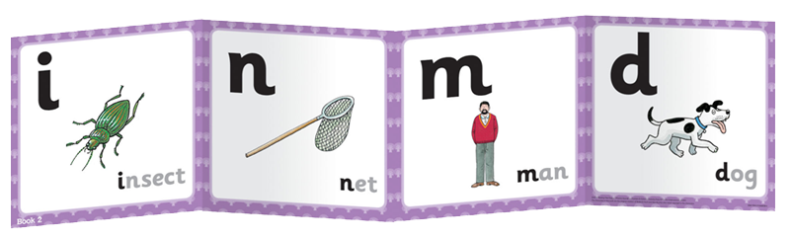

Classroom display
Level 1+ to 4 Frieze strips
correspond with each
FP Sounds Book

Slide 9
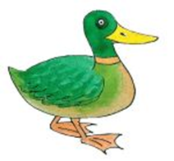



Mnemonic picture-words
/k/
c a t k ey d u ck
‘Mnemonic’ means ‘aid to memory’.
Picture-words and their printed words make the learning of the different sounds and spellings more memorable and manageable and can clarify the teaching and learning for adults and children alike.

Slide 10
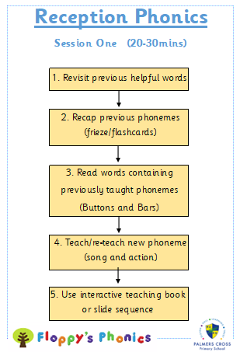
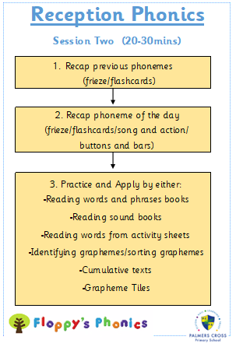
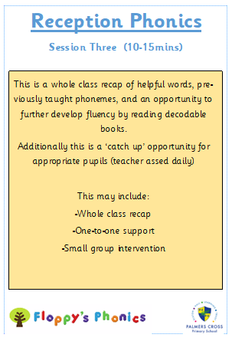

Slide 11
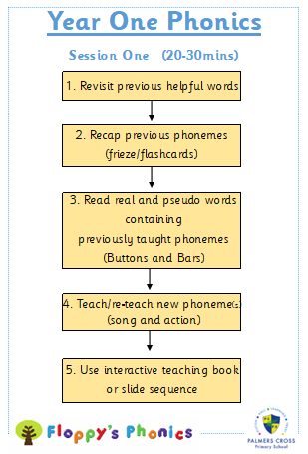
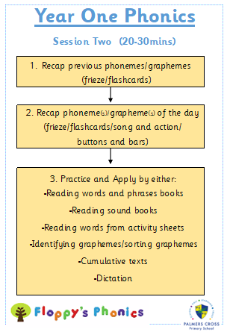
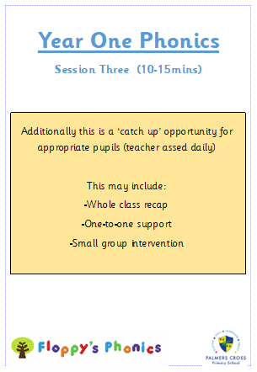

Slide 12
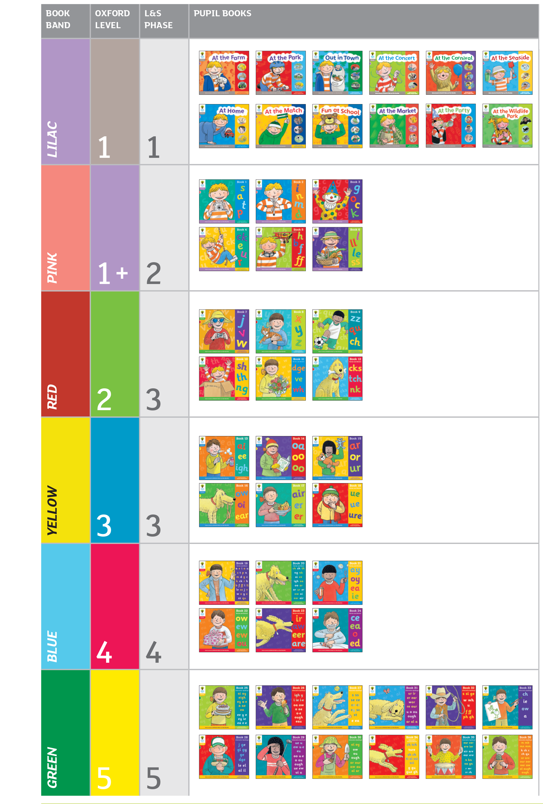
48 Sounds Books
6 level 1 ‘cloud books’ not interactive
When letters and sounds are introduced, the books are numbered Book 1, Book 2, Book 3
(36 numbered books)

Slide 13
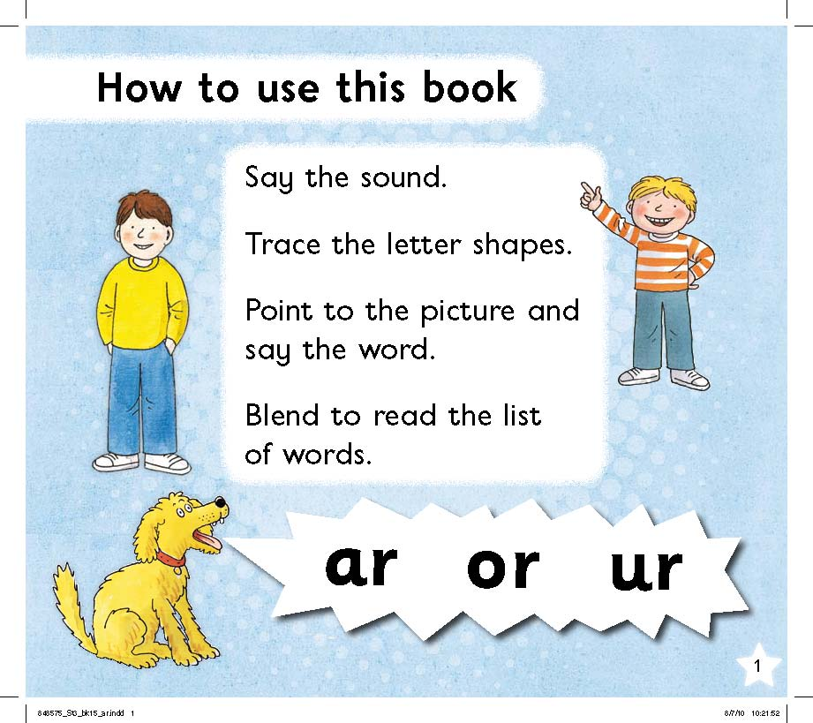
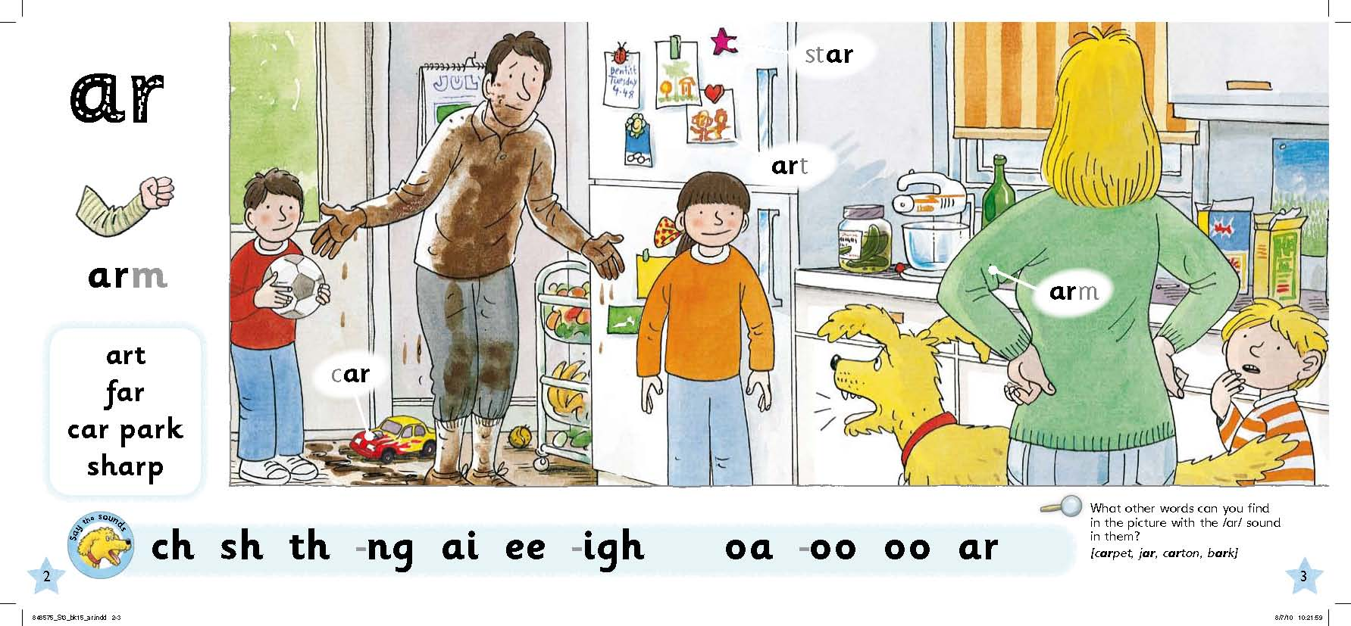
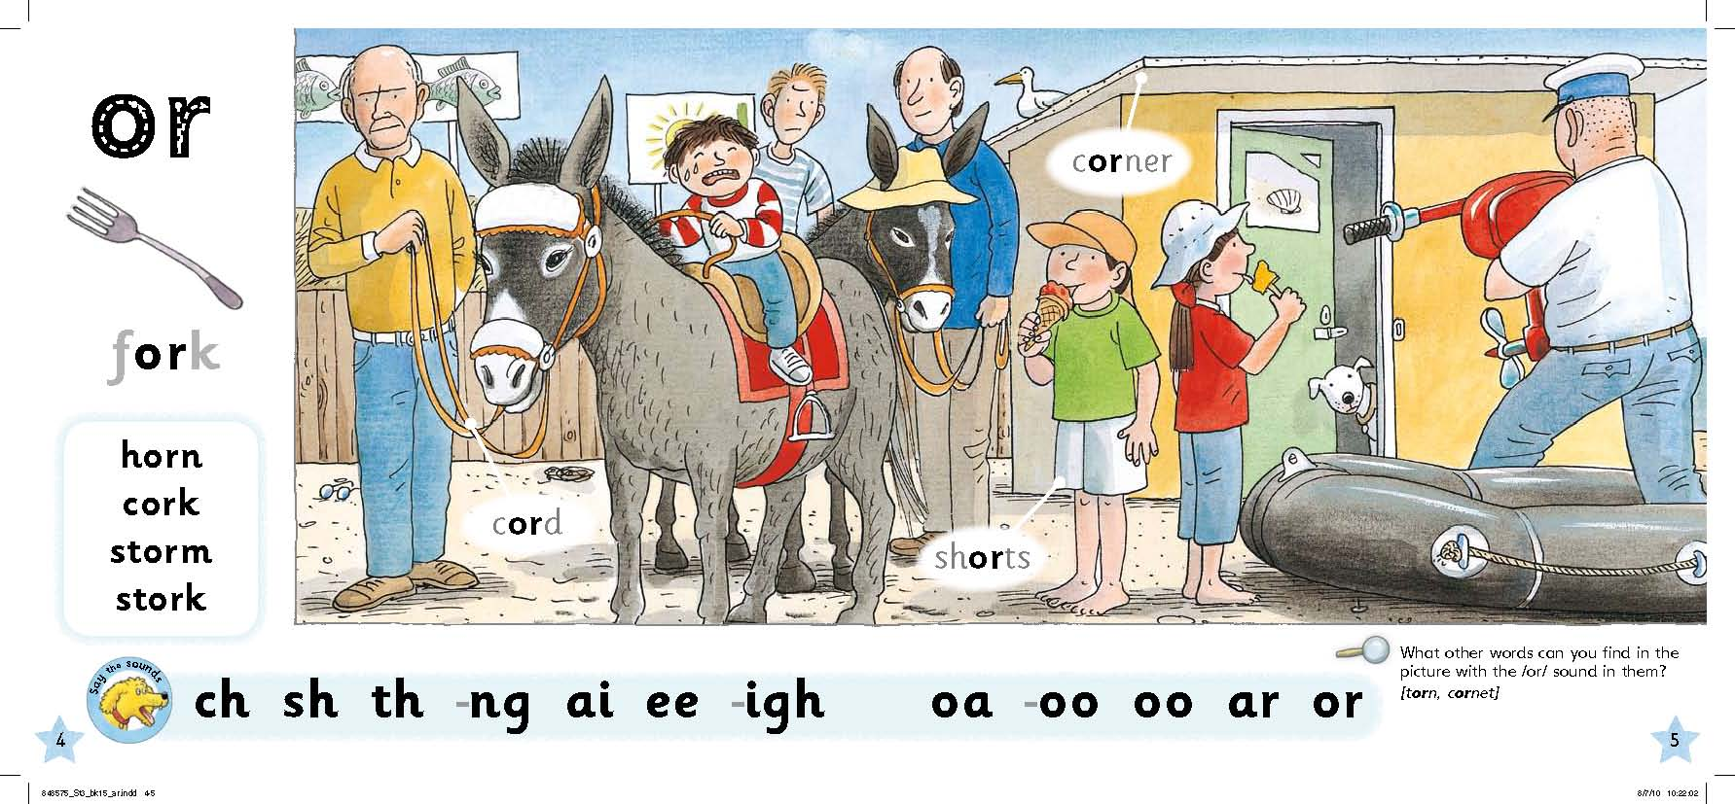
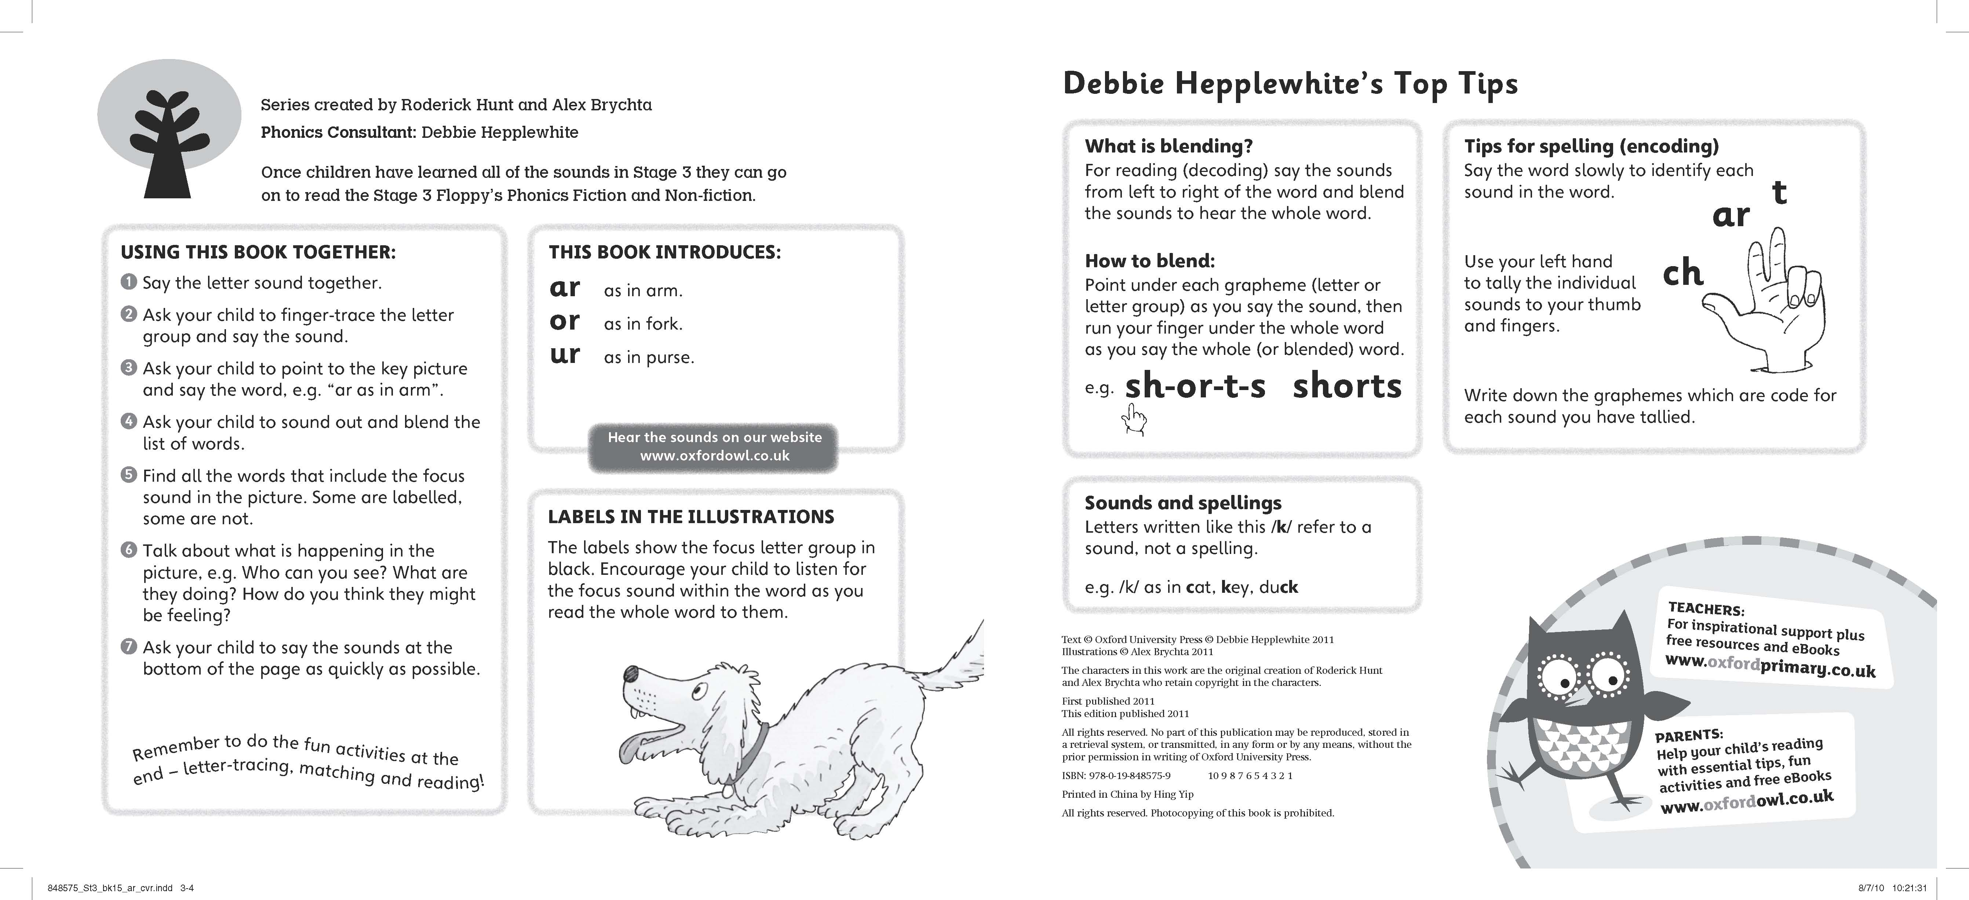
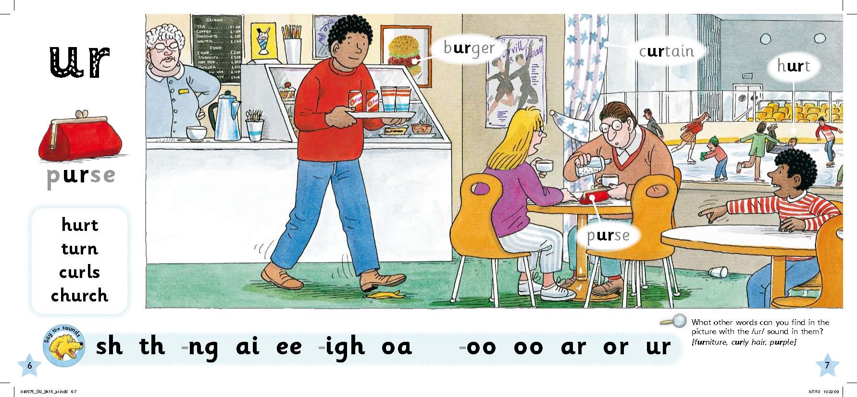
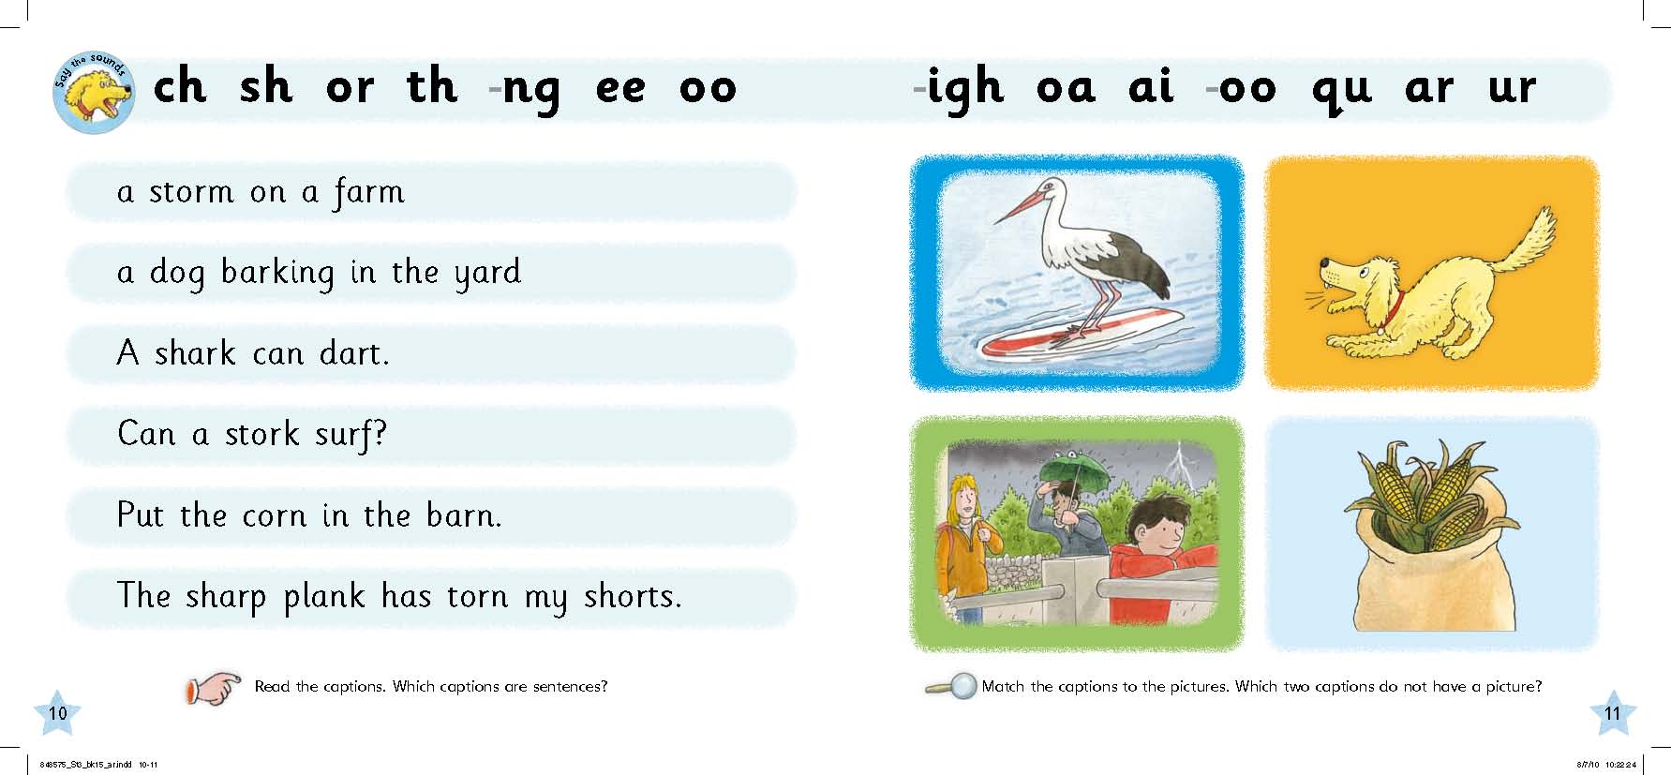
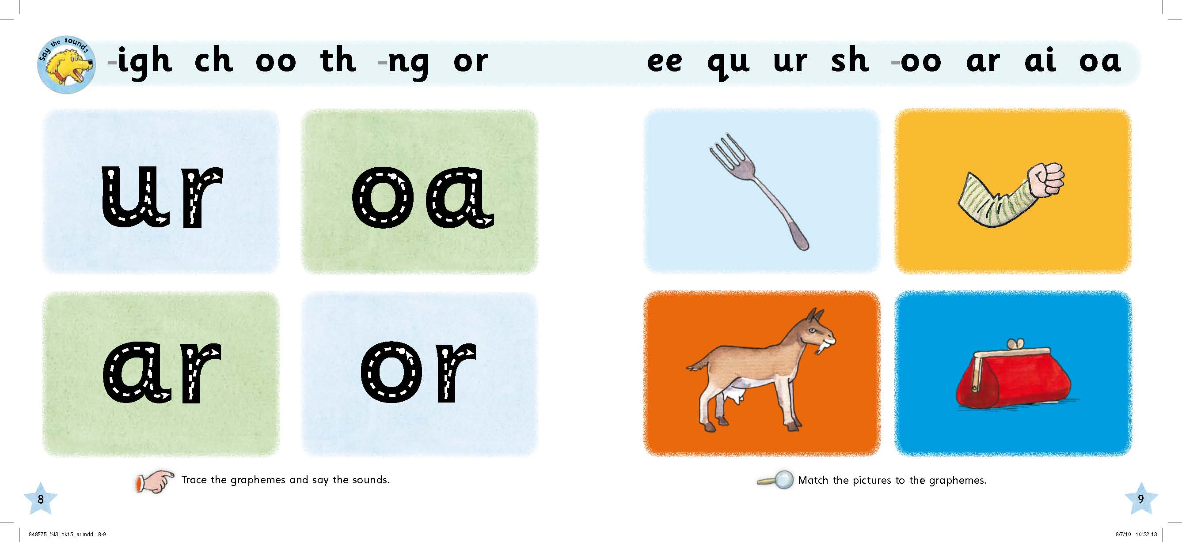
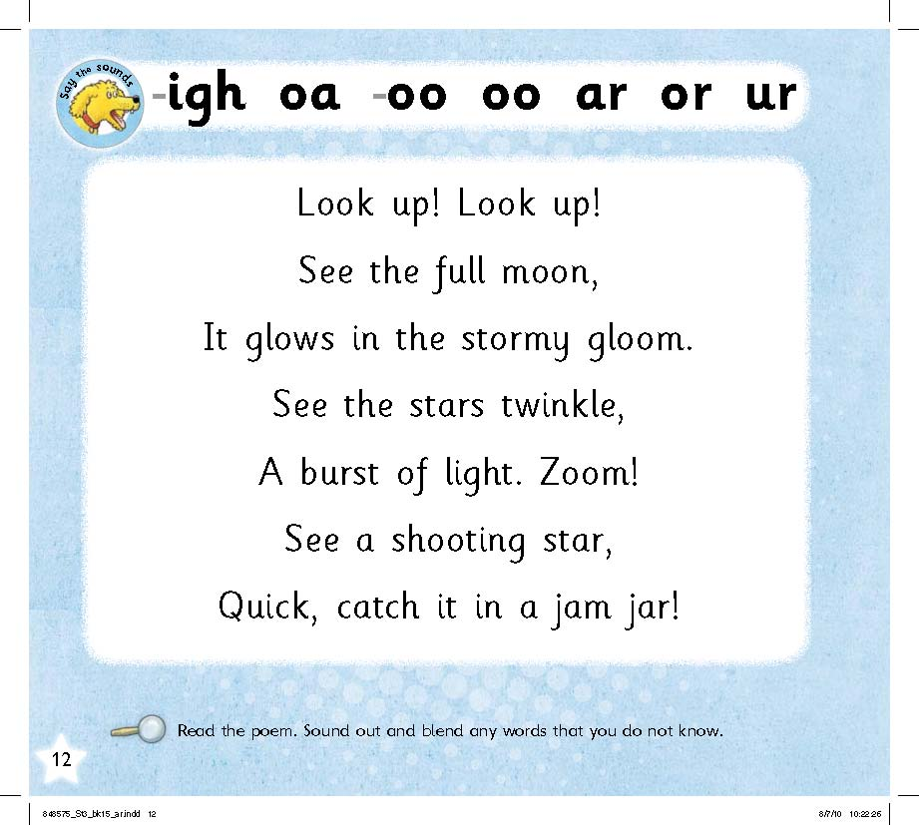
Inside the Floppy’s Phonics Books
These pages are on the digital platform
with audio
These ‘end pages’ are not
on the digital platform

Slide 14
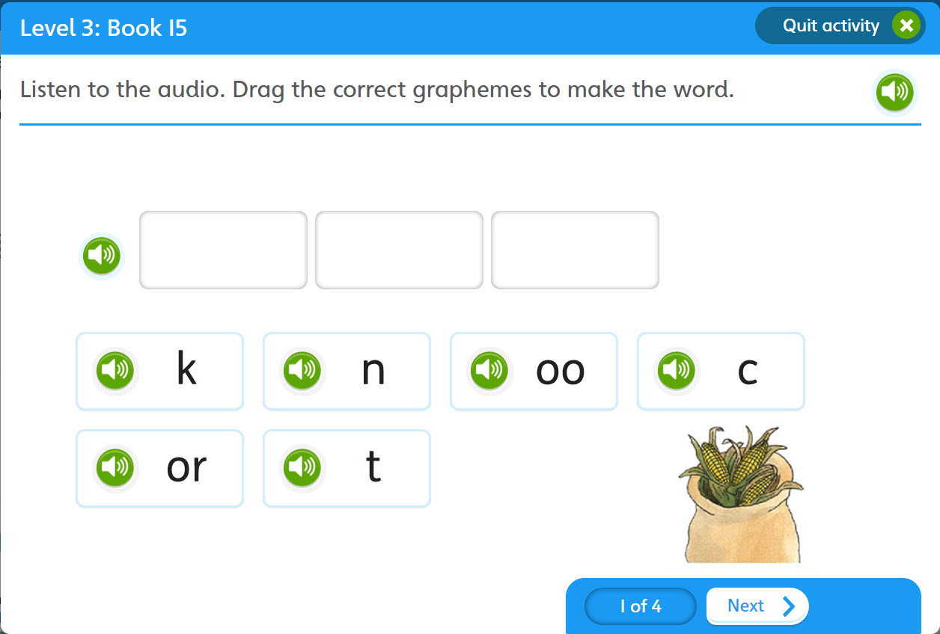
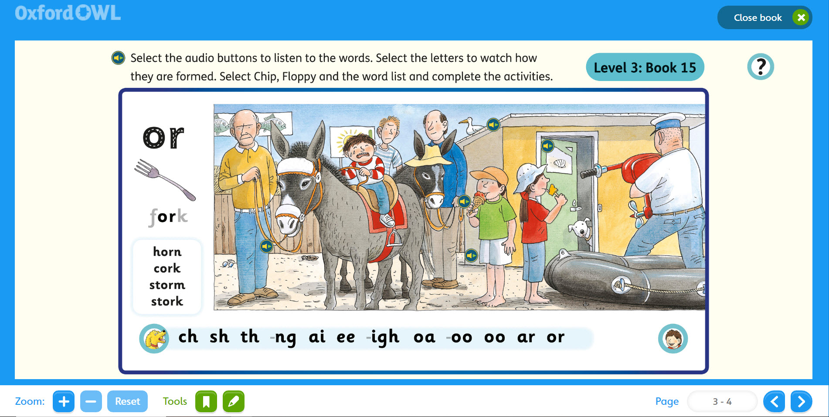
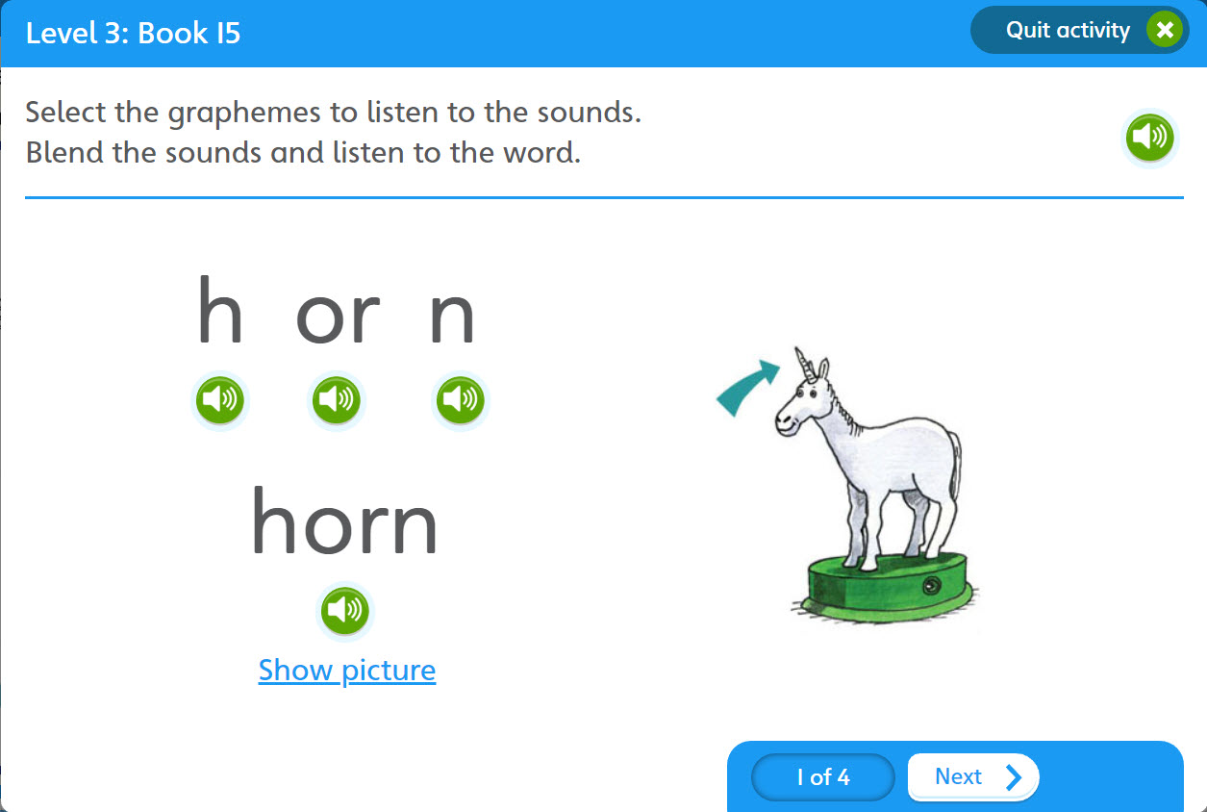
Interactive lessons
Select the letters to watch
letter formation
Drag and drop
for spelling
See the letter/s,
say the sounds
Hear the sounds,
point to the graphemes
Blend and reveal
for reading

Slide 15
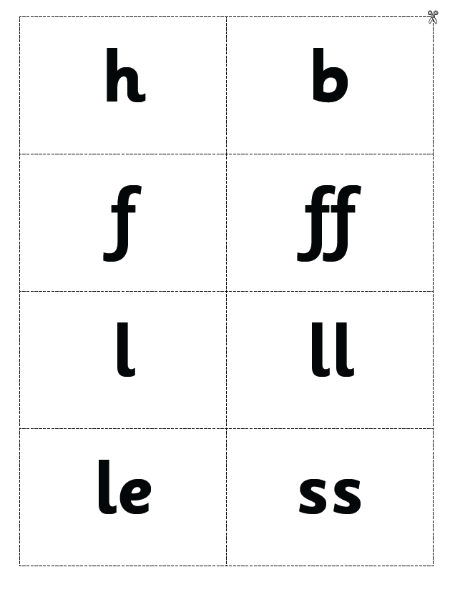
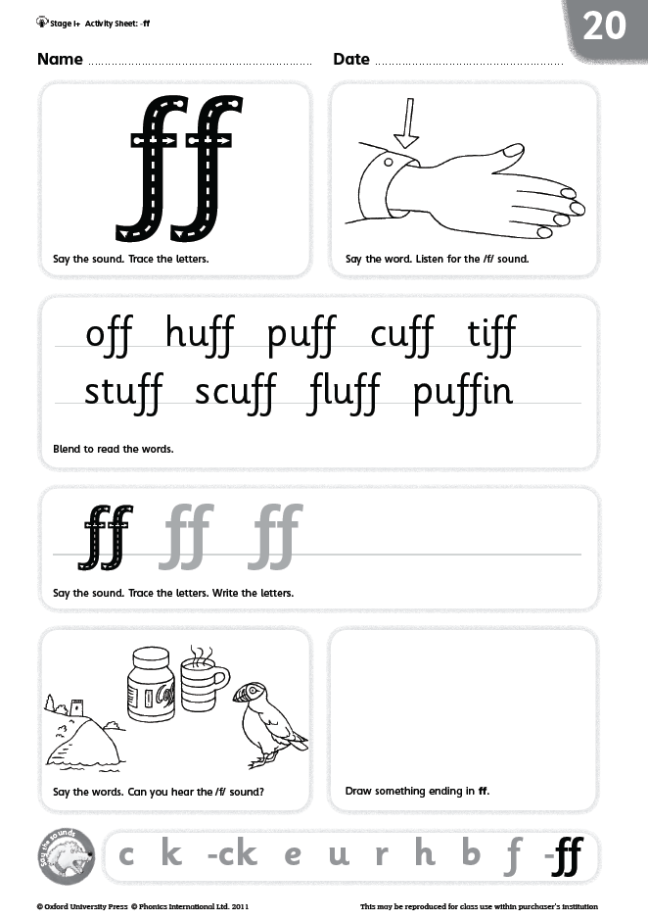
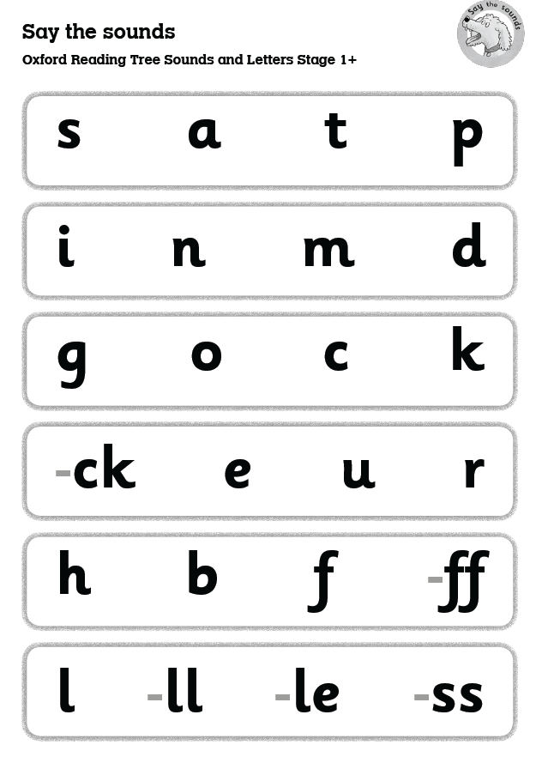
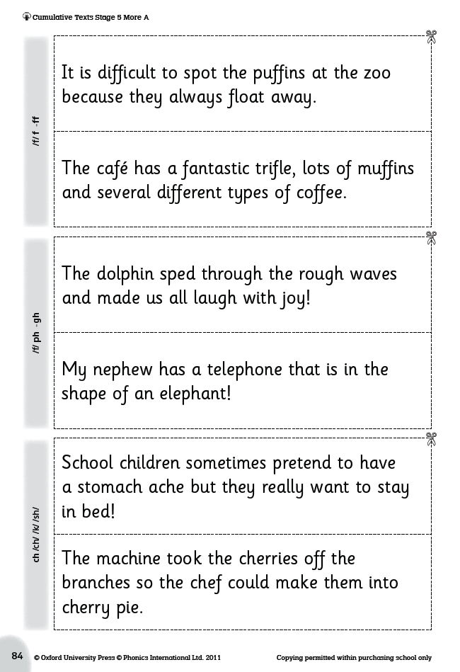

Session 2 Application of skills
Grapheme Tiles
and
Picture Tiles
Activity
Sheets
1 to 134
Say the Sounds
Posters
Cumulative
Texts
From ‘-ck’

Slide 16
‘Helpful Words’
Tricky words that are learnt by sight, are introduced steadily throughout systematic synthetic phonics programmes.
For example-
the to go of

Slide 17
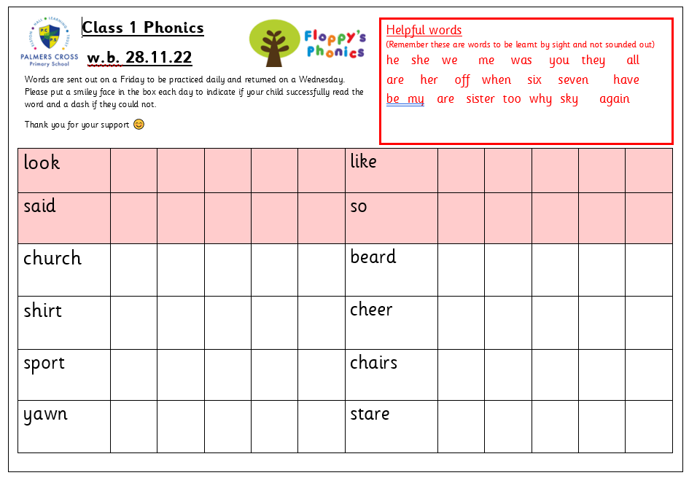
Read at home resources

